Slide 1


PLANET YOUTH AND THE ICELANDIC MODEL
LESSONS FOR YUKON
(and other PTs?!)
Notes:
INTRO

Slide 2
Émile Durkheim (1858 –1917)
Sociology should study phenomena attributed to society at-large, rather than being limited to the specific actions of individuals.

Slide 3
The Planet’s Core
“Children are viewed as social products and not as rational individual actors, and hence alcohol, tobacco, and other drug use is viewed as attributes of the social environment and engrained in both risk and protective factors that comprise key determinants of the ongoing cycle of substance use.”
Kristjansson,et al Development and Guiding Principles of the Icelandic Model for Preventing Adolescent Substance Use. Health Promot Pract. 2020;21(1):

Slide 4
MORE PEOPLE REACHED
LESS EXPENSIVE/PERSON
FEWER PEOPLE REACHED
MORE EXPENSIVE/PERSON
Eriksson and Lindström (2008)

Slide 5
Investing our effort and resources
“Many of the prevention initiatives currently underway are focused on changing individuals’ health behaviours through mass media campaigns, counselling and education. These methods have been shown to have the smallest impact on health, and the lowest return on investment.”
Putting People First: The final report of the comprehensive review of Yukon’s health and social programs and services.

Slide 6
Prevention
PRIMARY
SECONDARY
TERTIARY
Prevention of initiation. Long-term. Often community-based or organizational (i.e schools)
Behaviour-change. Intermediate. Interventions. Often through programs
Mitigating life-threatening circumstances. Immediate. Usually through hospitalization/institutionalization

Slide 7
How Best to Prevent Substance Use?
PRIMARY PREVENTION
Prevent or delay recruitment of new users (long term)
Cost/benefit analysis = best return on investment

Slide 8
The Causes of Substance Use
Collective Responsibility
Individual Responsibility
“”cause” of the causes
substance
Use
“”cause” of substance use
Social and environmental risk and protective factors
lack of purpose, boredom, poor mental health, low school engagement, poor choices, etc,..

Slide 9

Summarizing the current situation..
“Yukon’s current health system emphasizes acute and specialty care. The focus is on addressing urgent issues and, to some extent, managing chronic illnesses rather than preventing them. Most resources are focused on fixing a problem once it has happened. There is no overarching strategy to prevent illness and promote health.”

Slide 10

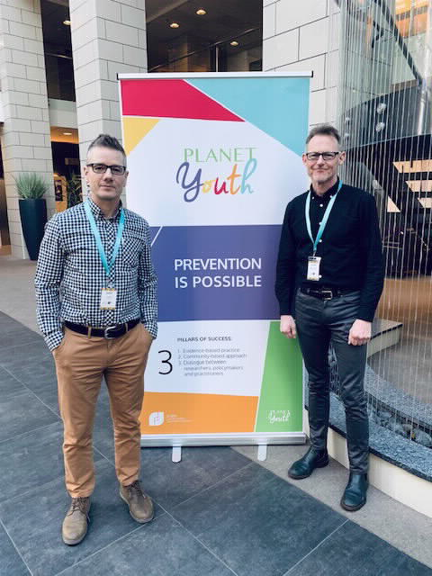
THE ICELANDIC MODEL

Slide 11
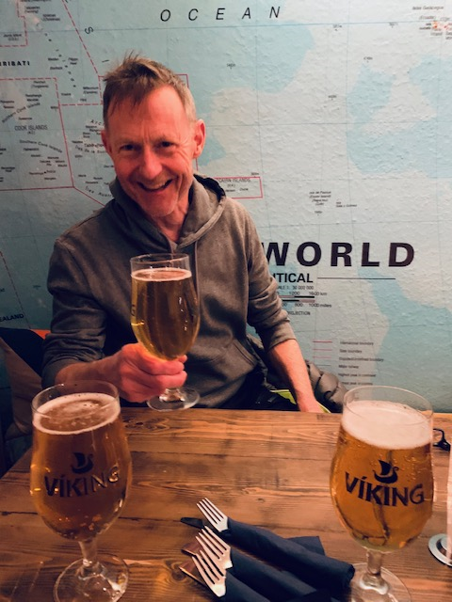
Actual Icelandic Viking

Slide 13
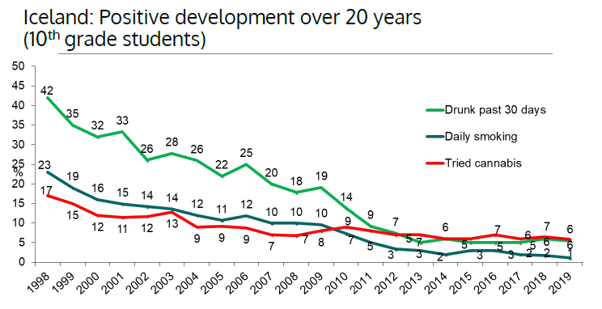

Slide 14
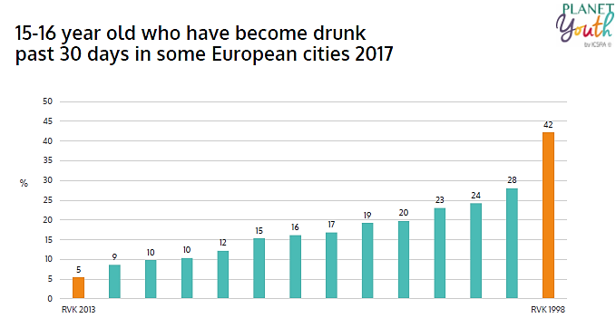

Slide 15
Three Pillars
Evidence-based practice (and practice-based evidence).
Community-based approach.
Dialogue between researchers, policy-makers and practitioners.
GOAL
Population-level delay in onset of use.

Slide 16
Four
Domains
LEISURE TIME
PEER GROUP
FAMILY
SCHOOL
INDIVIDUAL
LOCAL
SCHOOL
COMMUNITY

Slide 17
The 5 Guiding Principles of the Icelandic Prevention Model
Apply a primary prevention approach.
Emphasize community action and embrace public schools as the natural hub.
Integrate researchers, policy-makers, practitioners, and community members.
Match the scope of the solution to the scope of the problem.
Engage and empower community members to make practical decisions.
(Kristjansson et al. 2020)

Slide 18
1
Thoughtfully and intentionally altering the social, organizational, and cultural characteristics of communities.
Supporting local teams
Bridging the use of research evidence to practical implementation
Guiding Principle
Apply a primary prevention approach.

Slide 19
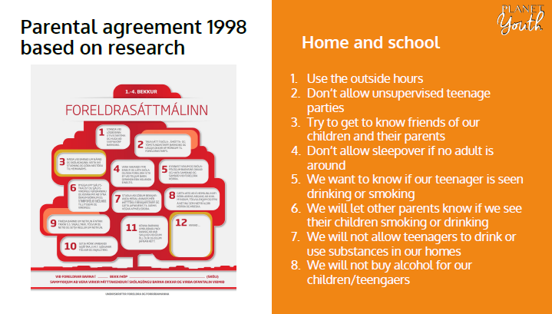

Slide 20
2
Schools represent an essential hub for local activities.
Strengthening connections between families, schools, and the community-at-large.
Securing collaboration and commitment of schools for the collection of data.
Guiding Principle
Emphasize community action and embrace public schools as the natural hub.

Slide 21

COMPREHENSIVE SCHOOL HEALTH
Health and Learning are profoundly linked
Joint Consortium for School Health
Ongoing partnership and collaboration with Yukon Education

Slide 22
3
Decisions based on hard data and neighbourhood and school-specific diagnostics
Accessible and current data promotes meaningful participation from the whole community
Collaborating with community-based researchers and supporting them to collect, process, and disseminate regular data is essential
Guiding Principle
Engage and empower community members to make practical decisions.

Slide 23
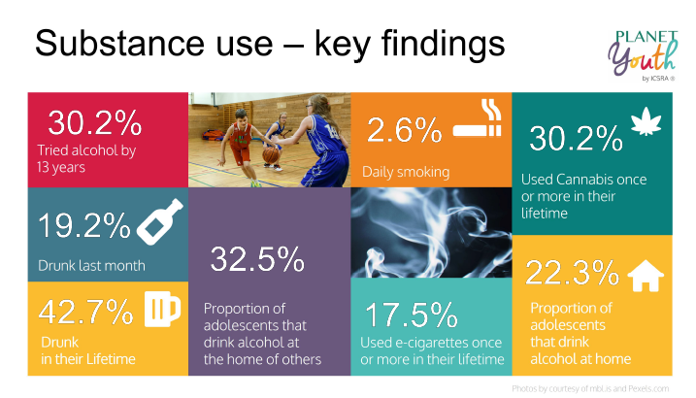

Slide 24
HEALTH BEHAVIOURS OF SCHOOL-AGED CHILDREN IN YUKON (HBSC)
CONCERNS
Rural students
Mental Health
Food Insecurity
Substance Abuse
Sexual Health

Slide 25
4
Science-to-practice approach with community teams working over long-term.
Each group/individual influences and is influenced by other team members.
Aligns the expertise and efforts of key players to maximize the practical, real-world impact of their collective capacity.
Guiding Principle
Integrate researchers, policy-makers, practitioners, and community members.

Slide 26
TASK
Speed-Up
and
Integrate
POLICY
PRACTICE
RESEARCH

Slide 27
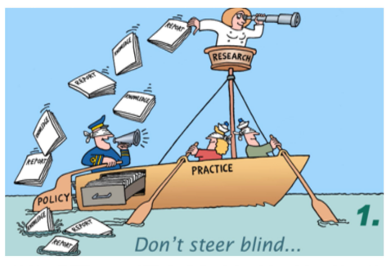

Slide 28
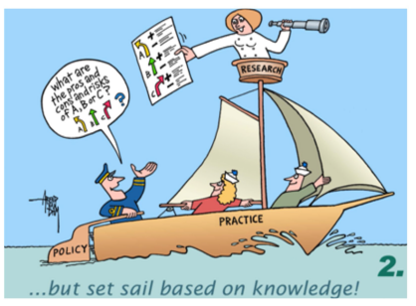

Slide 29
5
Contributing factors are complex and usually occur over long periods of time.
Long-term vision and planning, sustained commitment, iterative and repetitive approach, and stable financial resources required.
Applying primary prevention through lens of the model.
Guiding Principle
Match the scope of the solution to the scope of the problem.

Slide 30
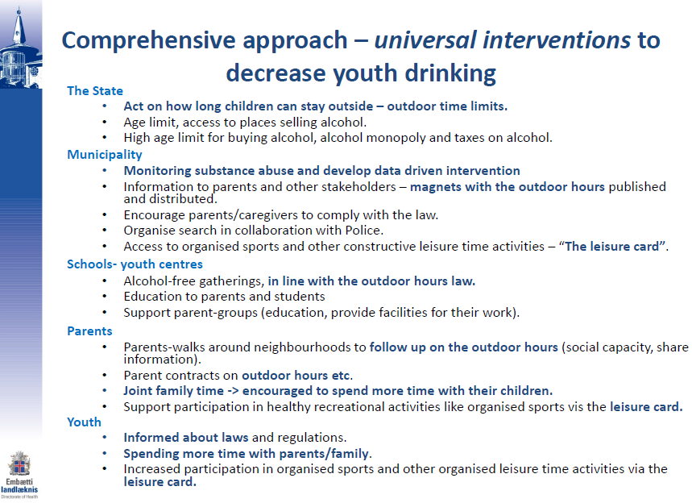

Slide 31

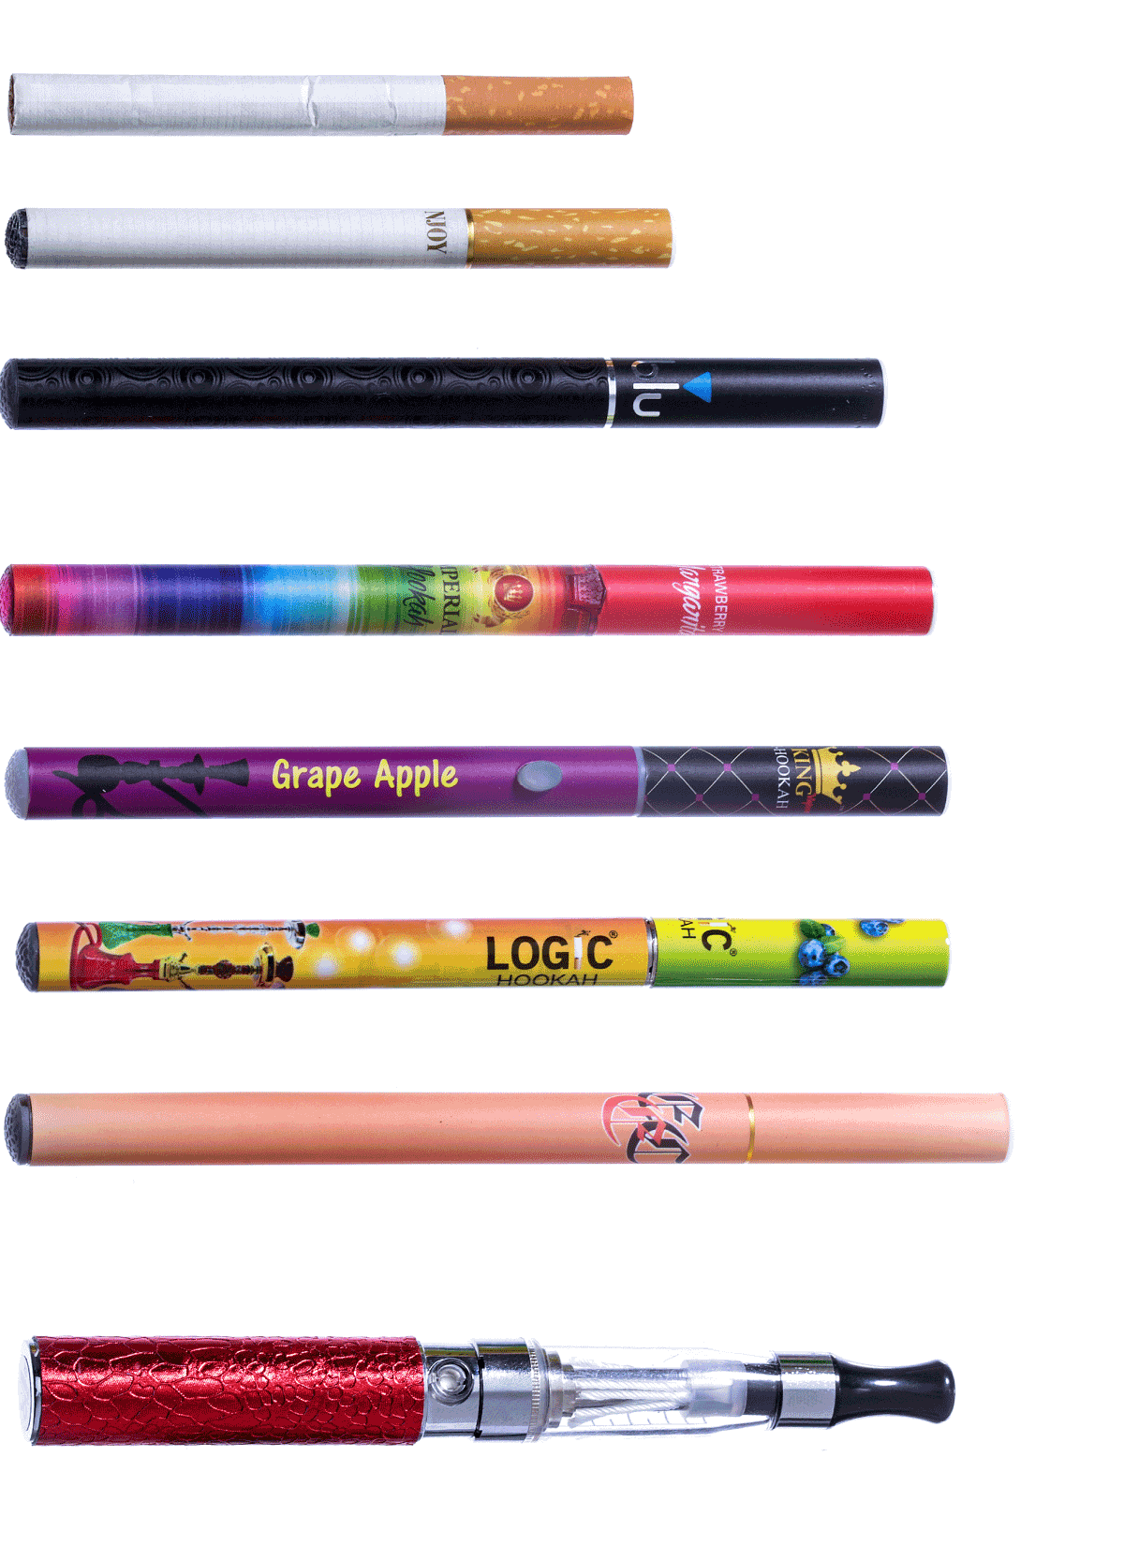
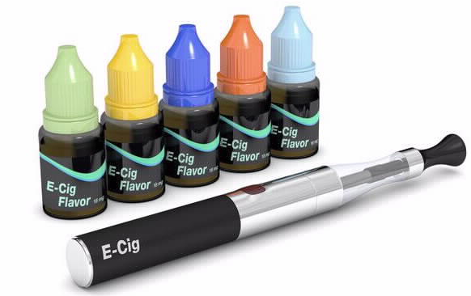

Youth Vaping in PEI
JCSH School Health Coordinators’ Committee
December 12, 2019

Slide 32
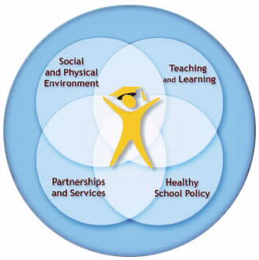
Comprehensive School Health
Health/Phys Ed
Grade 1-10 (mandatory)
- harms, decision-making, refusal skills
Grade 3-4
- refusal skills, harms of tobacco products
PETRA
Posters/Infographic
Health Canada
- Posters/Other Materials
Vaping
PEI SFPA/TESDSAA
- Not on school grounds
- Bans tobacco-like products
PSB Alcohol & Drugs Policy
- e-cigarettes = drug paraphernalia
Education / Health
Community
- Vaping web site, Infographic, Fact Sheets
SWT, H&S, PEI Lung, etc.

Slide 33
MENTAL HEALTH AND ADDICTIONS
“Some people with a mental health disorders will use substances to help them deal with their symptoms….young adults who misuse substances may increase their risk for mental disorders.”
A Child and Youth Mental Health and Addictions Framework for the Yukon (2014)
COVID-19
New studies reveal youth mental health deteriorating under pandemic stresses.

Slide 34
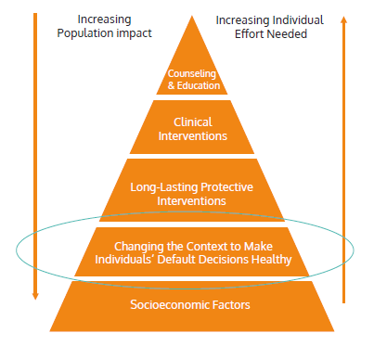
Recommendation 3.5 Adopt a universal approach to mental health and substance use prevention for children
and youth in Yukon that builds on the success of the Planet Youth model.

Slide 35














